Slide 1
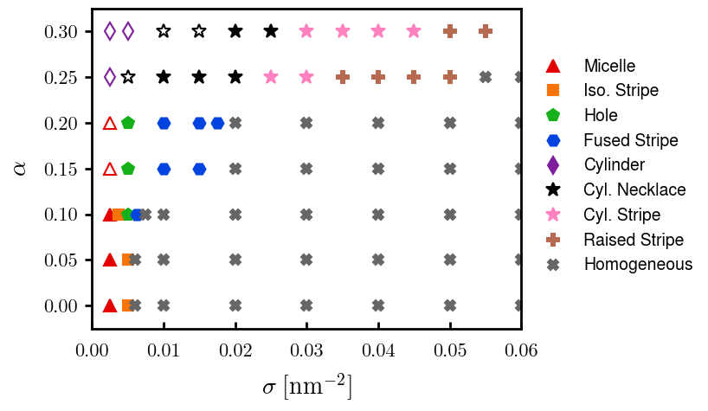
Current runs on phase diagram,

Slide 2



a00s3e3 - DONE
F= -1.77969
F = -1.77893
F= -1.77588, unstable

Slide 3










a00s5e3 - DONE
F = -2.986
F = -2.98574
F = -2.98733
F = -2.98580
F = -2.98637
F = -2.98644

Slide 4


a00s6e3 - DONE
F = -3.59170
F = -3.59404

Slide 5


a00s7e3 - DONE
F = -4.20090
F = -4.20224
Terran tried stripe (15.2, 20.2) & (12.2, 20.2). Unstable

Slide 6



a05s3e3 - DONE
F = -1.77283
F = -1.77232
F = -1.77005

Slide 7



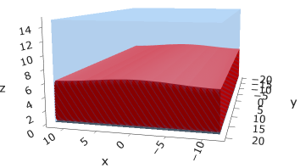
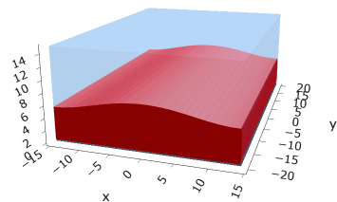
a05s5e3
F = -2.97229
F = -2.97422
F = -2.97319
F = -2.97365

Slide 8



a05s6e3 - TERRAN
F = -3.57664
F = -3.57732
F = -3.57783

Slide 9



a05s7e3 - DONE
F = -4.18090
F = -4.18116
F = -4.18226

Slide 10
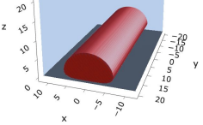
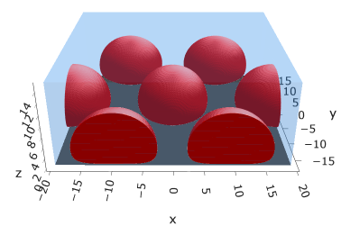
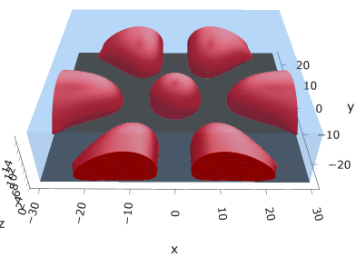
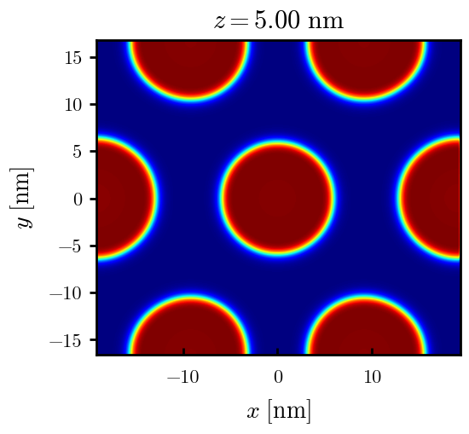
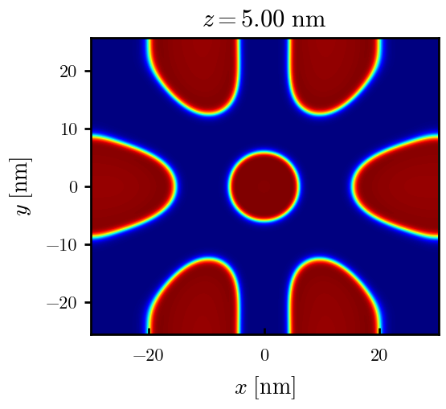
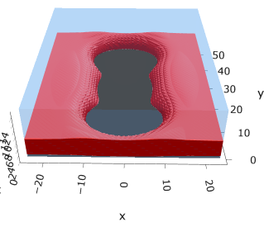
a10s2.5e3
Np / mic = 2
F = -1.45891 (np/mic =3, mic = 1)
F = -1.45840
Np / mic = 1
F = -1.45667
F = -1.45863
F = -1.45546

Slide 11
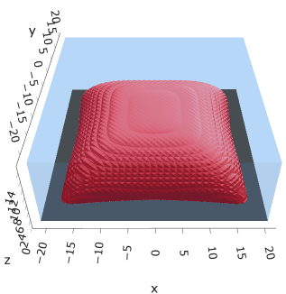
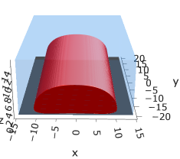
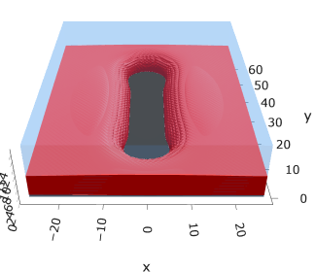
a10s3.75e3
F = -2.19744
F = -2.19763
F = -2.19618

Slide 12
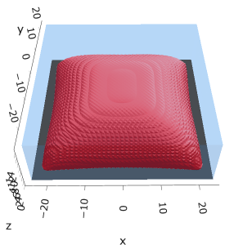


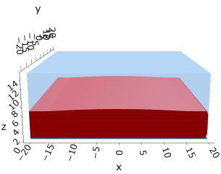
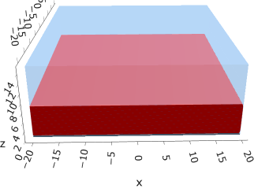

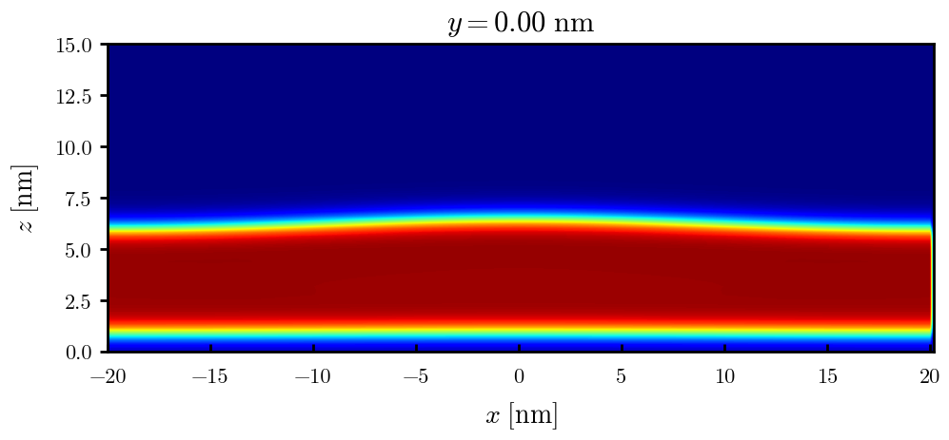

a10s5e3
F = -2.93747
F = -2.93851
F = -2.93859
F = -2.93847
F = -2.93848

Slide 13
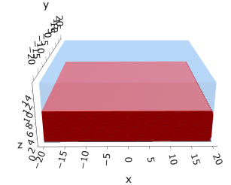
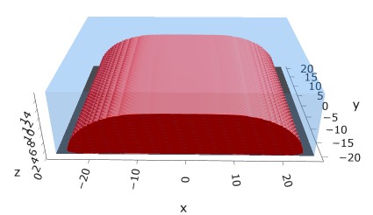
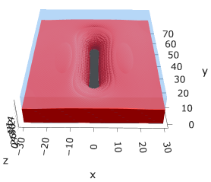
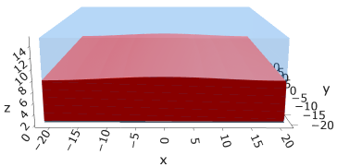
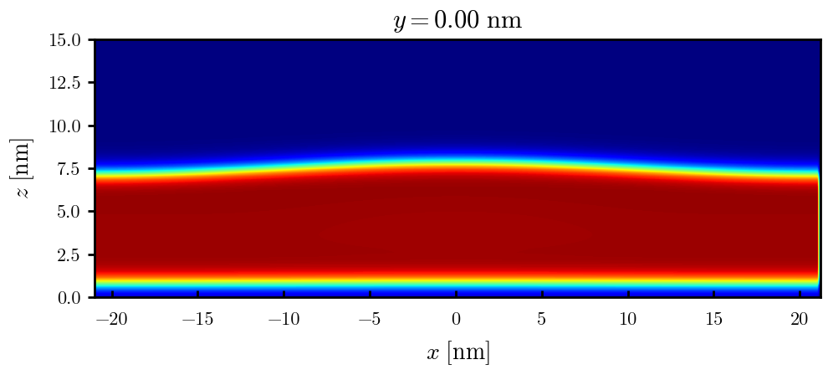
a10s625e3
F = -3.68015
F = -3.68121
F = -3.68176
F = -3.68177

Slide 14

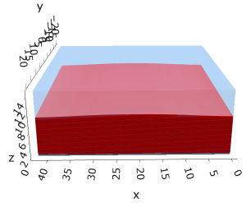

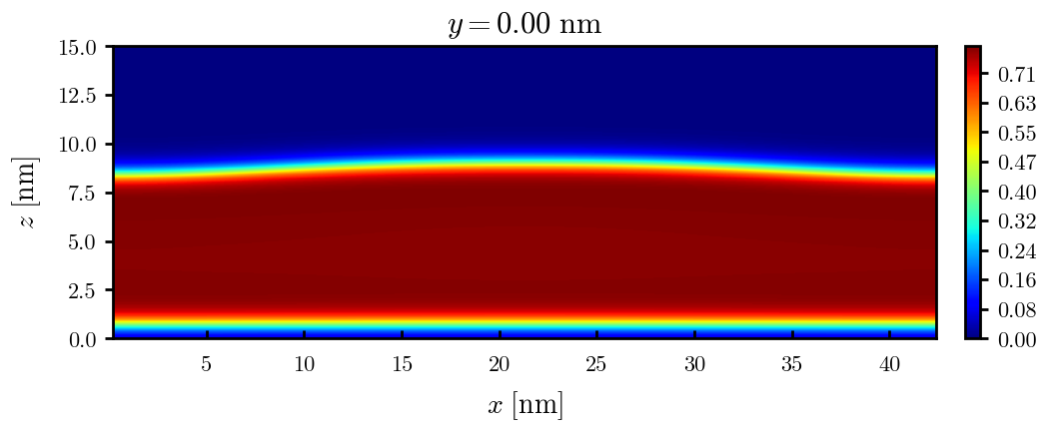
a10s0075
F = -4.42442
F = -4.42465
F = -4.42466

Slide 15


a10s010 - DONE
F = -5.90899
F = -5.90938
Josh tried hole. Unstable

Slide 16
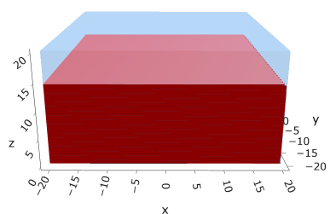
a10s0125
F = -7.39229

Slide 17
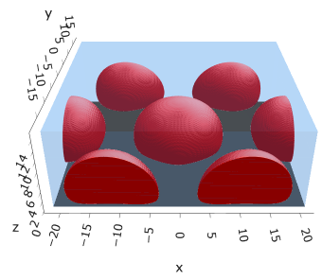
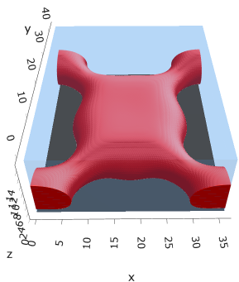
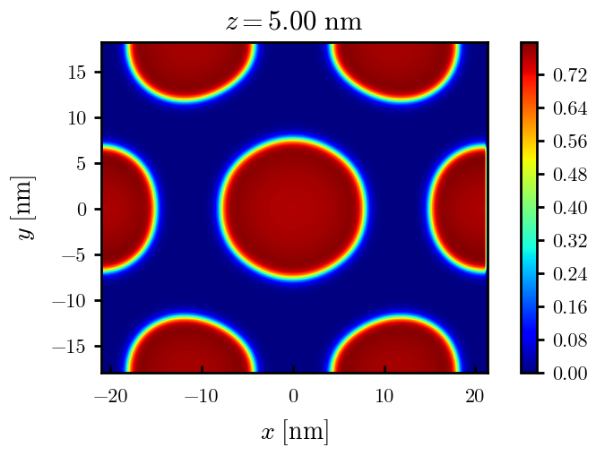
a15s2.5e3
F = -1.43609

Slide 18
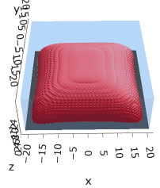



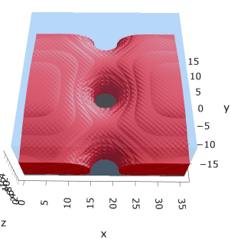
a15s5e3
F = -2.88508
F = -2.88602
F = -2.88654
F = -2.88482

Slide 19
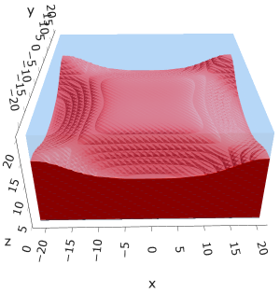

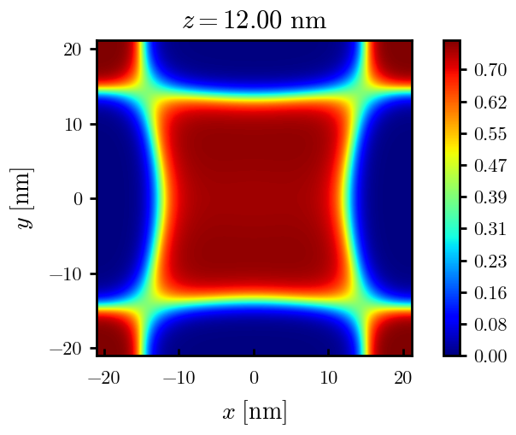
a15s1e2
F = -5.78561
F = -5.78588
Tried hole and didn’t work

Slide 20
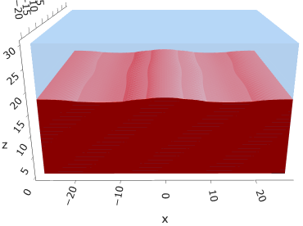
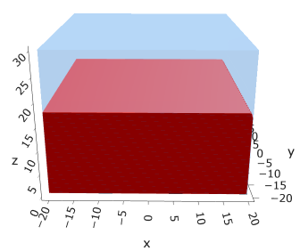
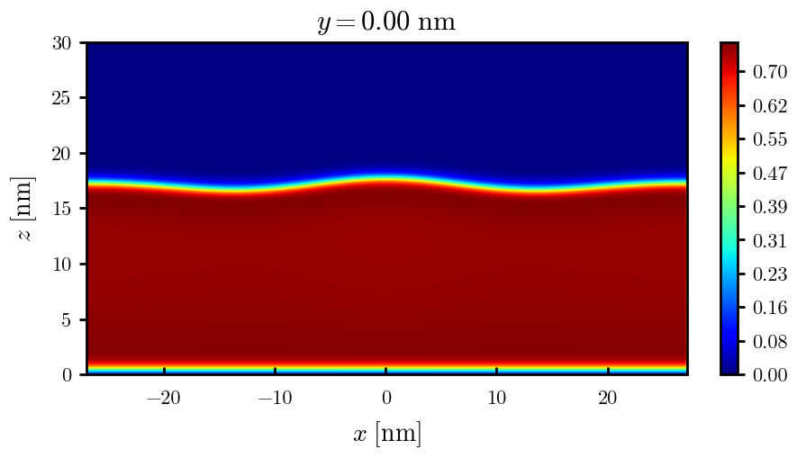
a15s015
F = -8.67754
F = -8.67750

Slide 21
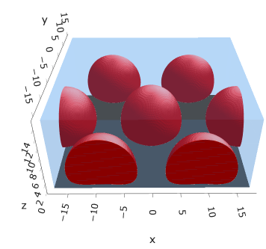
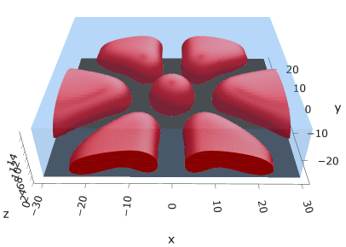
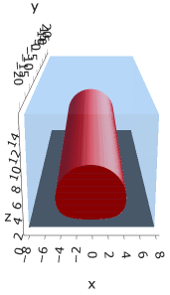
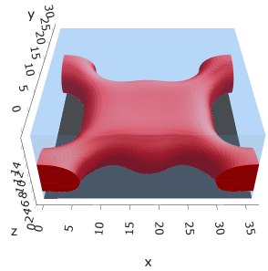
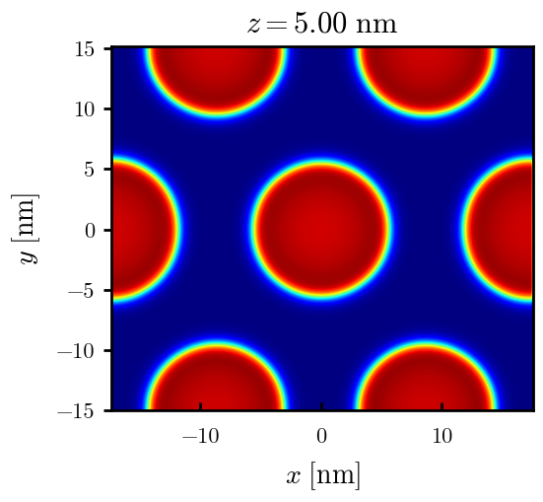
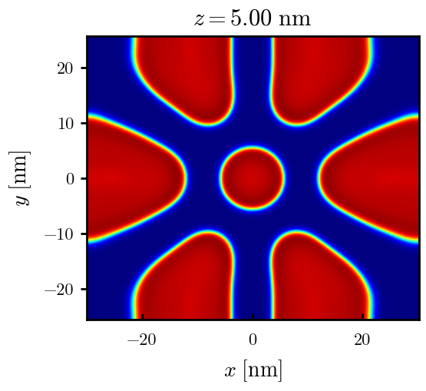
a20s2.5e3
Np / mic = 1
Np / mic = 2
F = -1.41139
F = -1.141071
F = -1.41154
F = -1.41046

Slide 22

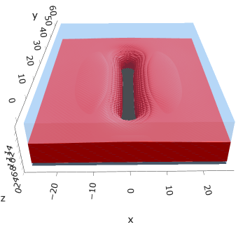
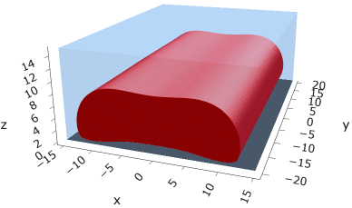
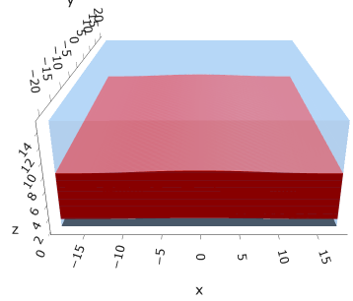
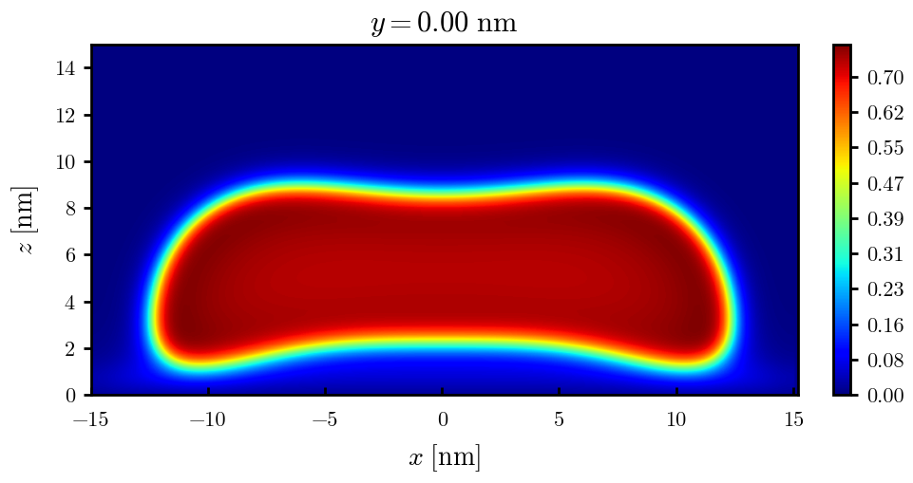
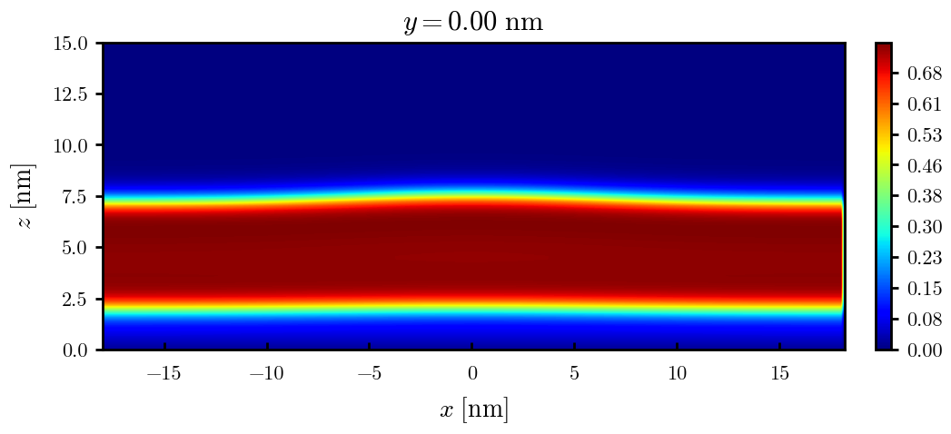
a20s5e3
F = -2.82154
F = -2.82217
F = -2.82208
F = -2.82020

Slide 23
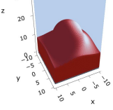
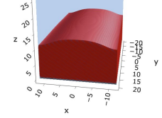
a20s010
F = -5.63481
F = -5.63514

Slide 24


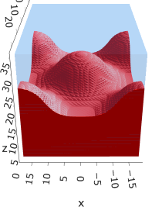
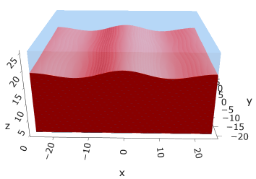
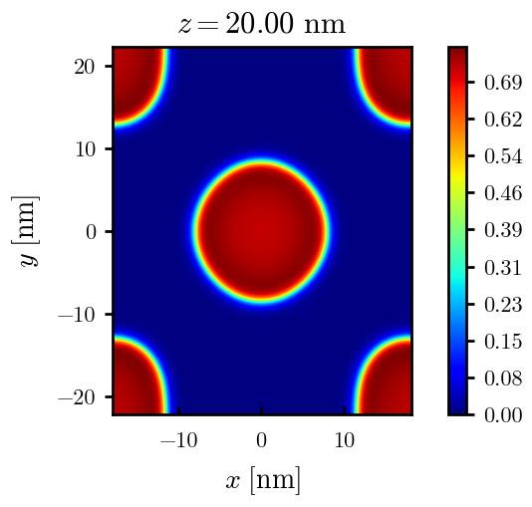
a20s015
F = -8.44011
F = -8.44081
F = -8.43935
F = -8.43930
n_coarse = 2

Slide 25



a20s0175
F = -9.83777
F = -9.83863
F = -9.83859

Slide 26





a20s020
F = -11.2312
F = -11.2319
F = -11.2321
n_coarse = 2

Slide 27



a20s022 – DONE
F = -12.3420
F = -12.3429
F = -12.3433

Slide 28




a20s025 - DONE
F = -14.0028
F = -14.0029
F = -14.0033
F = -13.9755

Slide 29




a20s027 - DONE
F = -15.1049
F = -15.1047
F = -15.0898
F = -15.1050

Slide 30



a225s025
F = -13.7769
F = -13.7774
F = -13.7775

Slide 31




a225s0275
F = -15.1288
F = -15.1293
F = -15.1292
F = -15.1293

Slide 32


a225s030
F = -16.4742
F = -16.4743

Slide 33



a25s2.5e3
Np / mic = 1
Np / mic = 2
F = -1.38178
F = -1.15791 (d25)

Slide 34






a25s5e3
Np / cyl = 1
Np / cyl = 2
F = -2.75823
F = -2.75519
F = -2.75918

Slide 35






a25s010
F = -5.47583
F = -5.48308
F = -5.48466
F = -5.48457

Slide 36












a25s015
F = -8.18187
F = -8.17785
F = -8.18516
F = -8.18884
F = -8.18878
F = -8.18865

Slide 37










a25s015 – cyl <> cyl-str
F = -8.18470
F = -8.18421
F = -8.18550
F = -8.18563
F = -8.18589

Slide 38









a25s020
F = -10.8712
F = -10.8748
F = -10.8775
F = -10.8775
F = -10.8766

Slide 39





a25s025
F = -13.5406
F = -13.5450
F = -13.5461
F = -13.5463
F = -13.5461

Slide 40






a25s027
F = -14.6059
F = -14.6065
F = -14.6030
F = -14.6015
F = -14.6022
F = -14.6018

Slide 41







a25s030
F = -16.1888
F = -16.1896
F = -16.1896
F = -16.1854
F = -16.1854
F = -16.1858
F = -16.1857

Slide 42






a25s0325
F = -17.4997
F = -17.4998
F = -17.4968
F = -17.4973
F = -17.4971
F = -17.4975

Slide 43




a25s035
F = -18.8025
F = -18.8025
F = -18.8000

Slide 44



a25s040
F = -21.3805
F = -21.3796

Slide 45




a25s045
F = -23.9208
F = -23.9202
F = -23.9000

Slide 46



a25s050
F = -26.4185
F = -26.4182

Slide 47



a25s055
F = -28.8703
F = -28.8706

Slide 48


a30s0025
F = -5.33410

Slide 49


a30s005

Slide 50

a30s010
F = -5.33225

Slide 51

a30s015
F = -7.93154

Slide 52











a30s020
F = -10.5092
F = -10.5098
F = -10.5108
F = -10.4996
F = -10.4878
F = -10.4764

Slide 53






a30s025
F = -13.0548
F = -13.0657
F = -13.0668
F = -13.0676
F = -13.0394
F = -13.0538

Slide 54







a30s030
F = -15.5953
F = -15.5962
F = -15.5965
F = -15.5886
F = -15.5897
F = -15.5739

Slide 55





a30s0325
F = -16.8494
F = -16.8486
F = -16.8312
F = -16.8491
F = -16.8268
2C isomin = 0.5

Slide 56







a30s035
F = -18.0782
F = -18.0779
F = -18.0943
F = -18.0948
F = -18.0946
F = -18.0887
F = -18.0782

Slide 57










a30s040
dz =0.15
F = -20.5583
F = -20.5585
F = -20.5593
F = -20.5582
F = -20.5549
F = -20.5390
F = -20.5384

Slide 58







a30s045
n_coarse = 2
dz =0.15
F = -22.9834
F = -22.9822
F = -22.9788
F = -22.9692
F = -22.9716

Slide 59





a30s050
dz =0.15
F = -25.3647
F = -25.3647
F = -25.3619
F = -25.3553
F = -25.3480

Slide 60




a30s055
F = -27.6992
F = -27.6993
F = -27.6917
n_coarse = 3

Slide 61


a30s060
F = -29.9840
F = -29.9775

Slide 63




a30s020, chi = 1.35
F = -10.3763
F = -10.3644
F = -10.3602
F = -10.3437

Slide 64





a30s040, chi = 1.35
F = -20.3489
F = -20.3492
F = -20.3446
F = -20.3275
F = -20.3219

Slide 65


a325s020
F = -10.2994
F = -10.2821

Slide 66




a35s020
Cyl?
3 “layers”
+1 dilute layer < isomin = 0.1

Slide 67





a35
s10
s12
s15
s18

Slide 68



Parallelization
$$α=0, χ=1.25, N=50, σ=0.02$$
$$α=0, χ=1.25, N=200, σ=0.005$$
$$L_{x}=L_{y}=23, { L}_{z}=15$$
Nth = 12: 500 it, 4.3 hrs
Nth = 8 : 500 it, 6.9 hrs
Nth = 6 : 415 it, 20 hrs (poss. mem bottleneck)

Slide 69







Exercise: Micelle / Stripe
s = 5e-03, N = 50, a = 0.0, x = 1.0
s = 5e-03, N = 75, a = 0.0, x = 1.0
Isosurface at pha = 0.1

Slide 70






a040x170s020

Slide 71






a040x170s010

Slide 72

a040x170s025

Slide 73














a040x170s022

Slide 74










a040x170 seed
See if becomes hex
cyl4-975
cyl4-12
cyl16-975
cyl16-1025
cyl1

Slide 75






a040x170s017

Slide 76












































a040x170s015 seed
Almost done
Almost done

Slide 77

















a040x170s013

Slide 78
















a040x170s010 seed

Slide 79














X200 x170 x130 x120 x100
F = −10.24458
F = − 9.14301
F = −11.0057
F = −10.2429
F = −11.0015
F = −9.63949
F = −10.2461
F = −10.9948
F = − 9.63030
F = −10.2431
F = −10.9953

Slide 80





a040x100 relaxation

Slide 81








































a040x100 seed
old
old

Slide 82


a040x120 relaxation
F = −10.24458

Slide 83





































a040x120 seed
cyl16-850
cyl16-825

Slide 84






a040x130 relaxation

Slide 85




a040x170 relaxation
F = −9.10347
1 neck

Slide 86







a040x200 relaxation

Slide 87










a040x200 seed
Note: not completely converged but stopped for resources

Slide 89


a0.40 x1.70

Slide 90





Zhulina JCP 1998
a = 0.01
0.1 mM
1 mM
May need to init using sine
10 mM
25 mM
Zhulina NVT; current GCE runs at Lz = 20

Slide 91

Carrillo Langmuir 2009

Slide 92

Parallelization

Slide 93
Equations
Quenched average, np, A --> \inf ; np/A → \sigma
Discrete Gaussian chain

Slide 94




Scaling (Alexander—de Gennes brush)
V = 4.2; H = 27.5 – 30.5
V = 2; H = 39 – 45.5

Slide 95







$φ_{p}$: DGC (3D; NxNy=1) vs MDE (1D)
Ns/sigs: dz = 0.10, Ngz_2 = 4$σ$; Chis/bs: dz = 0.25, Ngz_2 = 3.5$σ$

Slide 96


Numericals
Ys
Possibly do Ngz for multiple dzs

Slide 97








3D
Lxy = 1
Lxy = 10
Lxy = 5
Lxy = 15
y-z heatmaps for $φ_{p}$ at constant x

Slide 98





z-FFT vs z-FD (MDE) – REDFT01 xy(z)
Lx = 5, Ly = 5, Lz = 50. s = 0.02. x = 0.75. a = 0.00, N = 50
3D vs 1D (dashed): dz = 0.5, ds = 0.20; dz_1D = 0.113, ds_1D = 0.083
FFT (xyz)
FFT (yz vs pha)
FD (xyz)
FD (yz vs pha)
Diff btw 1D/3D should just be dz, ds, etc.

Slide 99
Specifying Grafted Points

Slide 100
Strategy
2D binary array for surface sites of homogeneously grafted polymer given grafting density, simulation box size, and discretization (and assuming dx = dy)
Fullspace must be periodic on x0 = xL, y0 = yL
Halfspace must be even on xL/2 and yL/2 (overlap of boundary following REDFT00) and periodic on x0 = xL, y0 = yL.
Homogeneous spacing as determined by regular hexagon, where grafting point at centroid of hexagon
In case there are edge effects, try shifting the centroids away from the boundaries of the xy-plane (only did for fullspace)
Make sure no edge effects by comparing results of full FFT with cos FFT

Slide 101
Test conditions
Sigma = 0.05 c/nm2
Lx = 15 nm
Ly = 15 nm
dx = 0.4 nm
Cast in terms of dx (for rounding and PBC for grafting points):
Sigma = 0.0668 c/nm2
Lx = 14.80 nm
Ly = 11.20 nm
(Sigma error decrease with dx)

Slide 102

Padded PBC (Full FFT)
Hexagons drawn for illustration of hexagon approach

Slide 103

Unpadded PBC (Full/Cos FFT)

Slide 104






Other conditions (full and half results overlapped to show match)
s = 0.0241 (20.28%; dx=0.4), Lx, Ly = 12.40, 20.80
s = 0.0208 (4.08%; dx=0.1), Lx, Ly = 12.90, 22.30
s = 0.1332 (11%; dx=0.1), Lx, Ly = 20.50, 20.40

